Slide 1
EaseInfy
Presented by:
151466 Hitesh Gupta
151215 Prashant Chauhan
151234 Ayushi Manchanda
151474 Akriti Goyal
151223 Pritish Mukherjee
151240 Samiksha Gupta
Supervisor:
Mr. Joshua Thomas, System Engineer, ETA, Infosys Mysore

Slide 2
Review
Realizing the difficulties and needs of the campus, our team tried to make a project named EaseInfy where the key idea was to make our daily lives easier. We analyzed the problem of long ques for ordering the food and booking movie tickets on weekends. There came the idea of digitalizing the entire process by making a platform where we can get all the details of food courts and make the payment using OTP.

Slide 3
Introduction
There were numerous problems faced by the people like waiting in long queues for the payment and selection of food, Vendors did not have a proper platform to update menu.
Therefore, the entire idea of developing a Web Application was to get one platform to perform the above mentioned tasks.
The aim was to:
For Food Courts:
View all the food courts and its availability.
View of the vendors and its menu.
Generation of OTP for ordering the food items.
For vendors, alteration in menu.
For streaming movies in Multiplex:
Prior information about the movies streaming next weekend.
Checking the availability of seats for a particular time of the show.
Generation of OTP for the verification of user.
Booking of tickets.

Slide 4
Objective
To create a website that has a user friendly Interface.
To create a website which enables the user to view the list of food courts, food items and vendors to update the food items list.
To create a website which enables the user to view the movies streaming for the weekend and book the tickets.

Slide 5
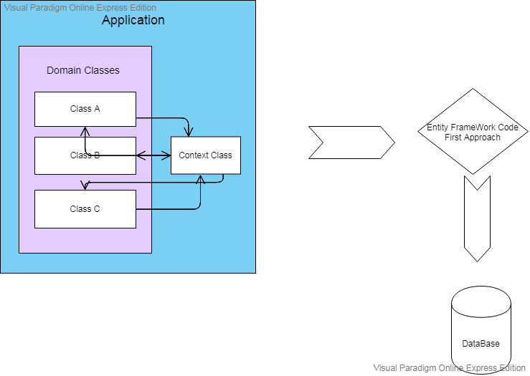
Design and Architecture

Slide 6
User Interface and Hardware/ Software Platform
User Interface:
Should be easy to understand and user friendly.
Should adapt to different screen sizes.
Any user can view the web application but only registered users can avail the services.
Software:
Windows 7 Desktop
Platform:
Visual Studio 2017
Microsoft SQL Server Management Studio 2017

Slide 7
Components
The technologies used are ASP.net,
HTML
CSS
SQL queries
C#
MVC
The provided platform is Visual Studio for performing and testing and Microsoft SQL Server Management Studio 2017 for the database.

Slide 8
Methodology
The following methodologies were used for the implementation of our project.
Creation of Database using SQL server.
Creation of Web Application using MODEL VIEW CONTROLLER structure.
Creation of the DATA ACCESS LAYER to connect the MVC project to database.
Creation of ENTITY DATA MODEL DESIGNER.
Using Model classes for the basic structure of Views.
Use of Controllers and Views to perform the required functionality.
Use of HTML, CSS, BOOTSTRAP and JAVA SCRIPT to create an interface that is user friendly.
Performed Unit Testing, Integration Testing using white box approach.

Slide 9
Functionalities
Get All Food Courts: It extracts the name all the food courts from database with respect to their availability.
View Rating: It extracts top/most recent five ratings from the database.
Get All Vendors: It extracts the name all the vendors associated.
Get All Food Items: It is specifically for vendors and extracts the name all the food items that the vendor has uploaded.
Get Food items: It is specifically for the employees and extracts the food items that the vendors have mentioned.
Get Employee: It extracts all the details of the registered employees.
Get Food List by Name: The food items ordered by the user.
Get all Movies: Movies that the Vendor has mentioned for the weekend.

Slide 10
View Customers: Extract the details of the customers that have registered themselves.
Add Food Item: The recently added food items by the vendor are extracted.
Add FCoupon: Coupons that can be added by the vendor including itemid, price and vendor id.
Bill Amount: It extracts the bill amount according to the price of the food item mentioned by the vendor.
Get Bill: Extracts the Bill details.
Get FCoupons: It shows the itemid, price and the vendor from which item is purchased.
Clear Bill: The database clears all the details of bill after its generation.
Get OTP: It extracts a random number for every entry.

Slide 11
Find OTP: It finds the OTP in the data set for the input given by the user.
Verify OTP: Checks if the generated OTP is same as that of Random OTP generated.
Delete Food Item: List of food items that are removed from the menu.
Validate Employee: At the time of login database checks the data with the existing data set.
Validate Vendor: At the time of login database checks the data with the existing data set.
Validate Movie Vendor: At the time of login database checks the data with the existing data set.

Slide 12
Update Employee: Any updation of new employee or updation of details of existing employee.
Update Food Item: The food items added/deleted by vendor is extracted.
Update Multiplex: The movie name, seat number, screen number, timings can be updated.
Get User: Users who availed the services from the vendors.
Register User: The basic details for the registration of Users.
Save Rating: Stores the rating done by the customers.

Slide 13
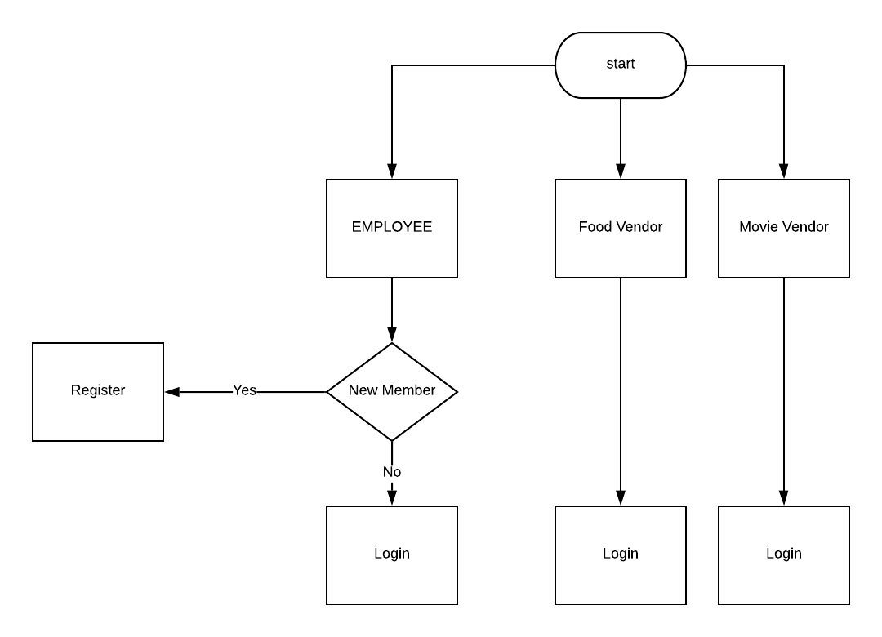
Functionalities of Employee

Slide 14
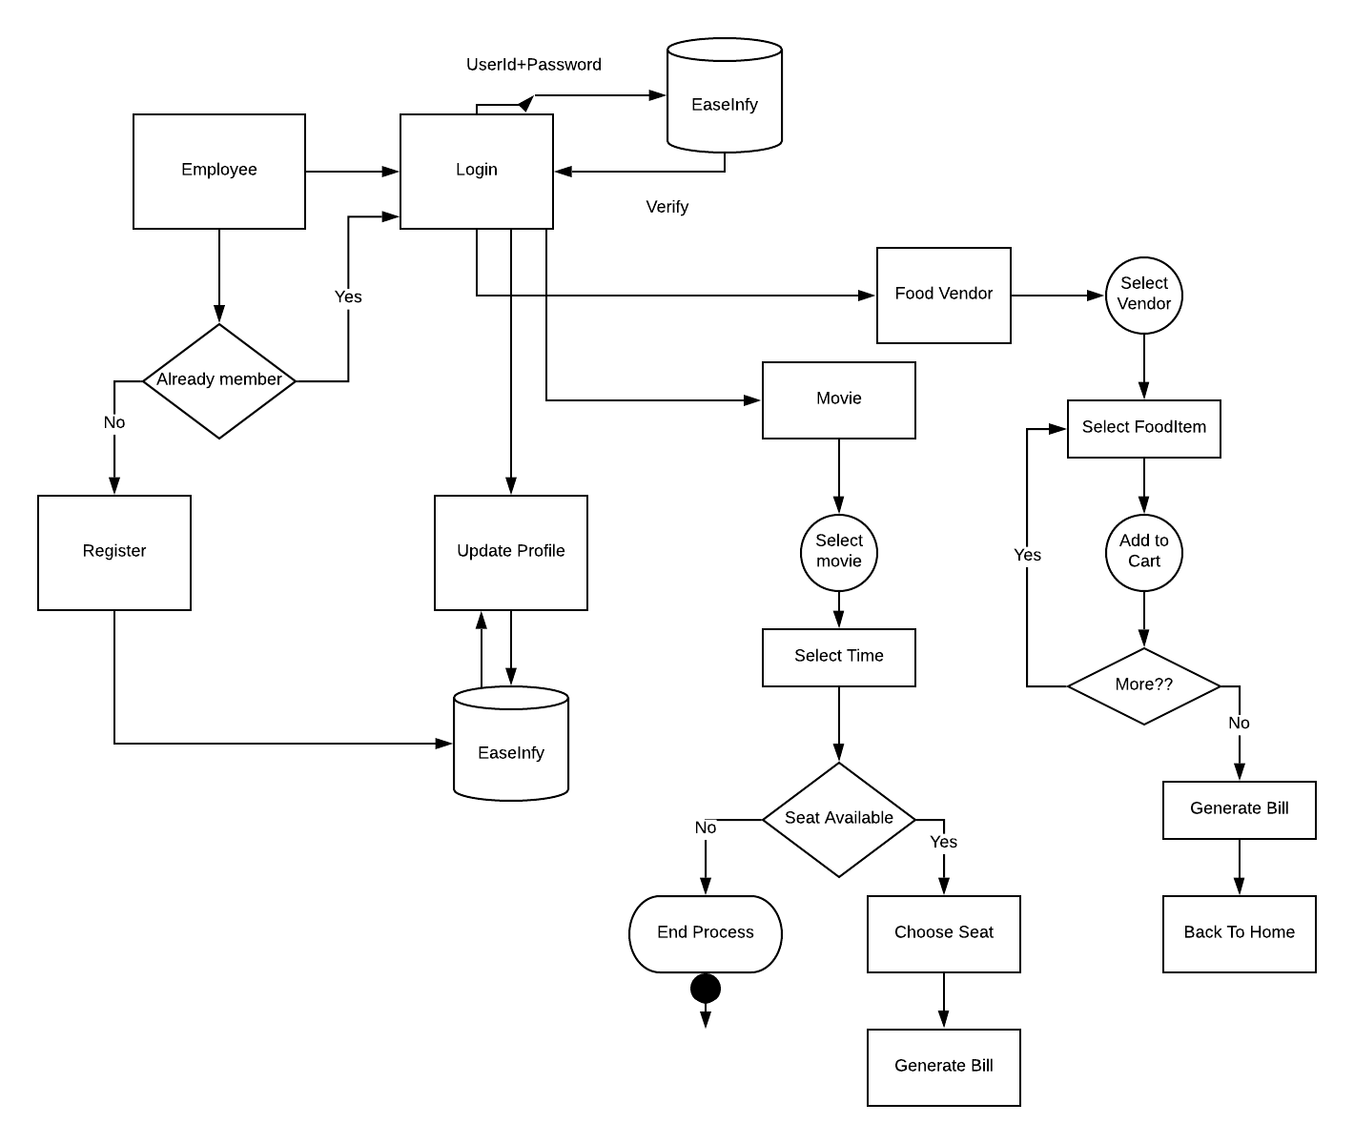
Functionalities

Slide 15
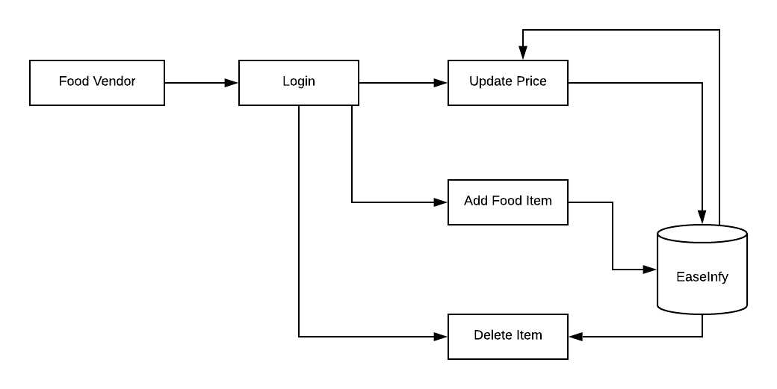
Functionalities of Food Vendor

Slide 16
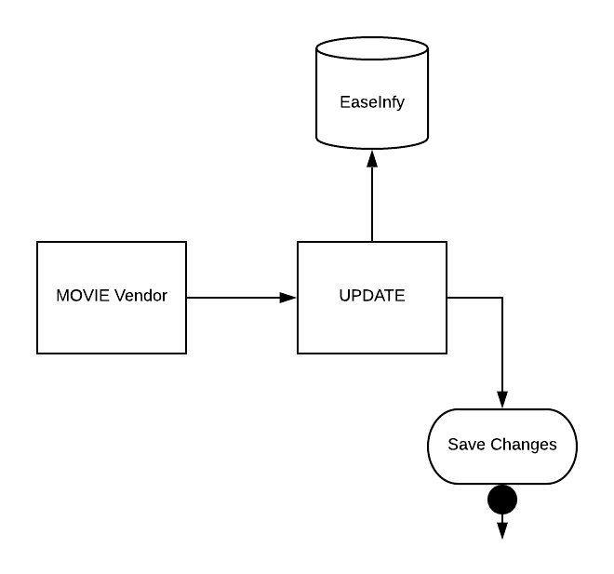
Functionalities of Multiplex

Slide 17
Conclusion
The entire project EaseInfy was up to the satisfaction of Our mentors/Clients. All the user requirements are fulfilled and the application works well in the intranet environment of an organization. The Application is well tested in different erroneous conditions and the errors are handled properly in debugging phase. The Users can login and logout successfully without facing any session error. The Application works fine in different conditions of respective systems. It can be improved further and can offer additional functionalities in terms of addition of payment portal.

Slide 18
Future Scope
The Application has covered all the requirements provided by the Client. It can be modified further to implement the extra requirements and functionalities and the improvements can be made easily. Improvements can be executed by adding new modules. Further enhancements that can be added includes:
Better User-Interface
More functionalities can be added with respect to the payment portal.
The web application can also be converted to an Android App for more frequent use.

